Slide 1
Introduction to Computing for Data Analysis
Case study: PageRank (Markov chains on graphs)
Richard Vuduc, Ph.D.
Associate Professor
School of Computational Science and Engineering
A connectivity-based ranking
of websites
Notes:
Well, if it isn’t you again? Welcome back.
For our next topic, I want you to go through an algorithmic case study, which is an algorithm called “PageRank.”
It was originally proposed as a way to rank web pages in order of “importance,” to help guide users through search results.

Slide 2
Introduction to Computing for Data Analysis
Case study: PageRank (Markov chains on graphs)
Richard Vuduc, Ph.D.
Associate Professor
School of Computational Science and Engineering
A connectivity-based ranking
of websites
Notes:
I picked this case study for you to help connect ideas from computer science, namely, the idea of a network or graph, with ideas from mathematics, namely, Markov chains from probability theory plus linear algebra.
These connections have a practical implication, too, which is that you can sometimes code up network or graph algorithms using tools from linear algebra.

Slide 3

Notes:
Here is the context.

Slide 4
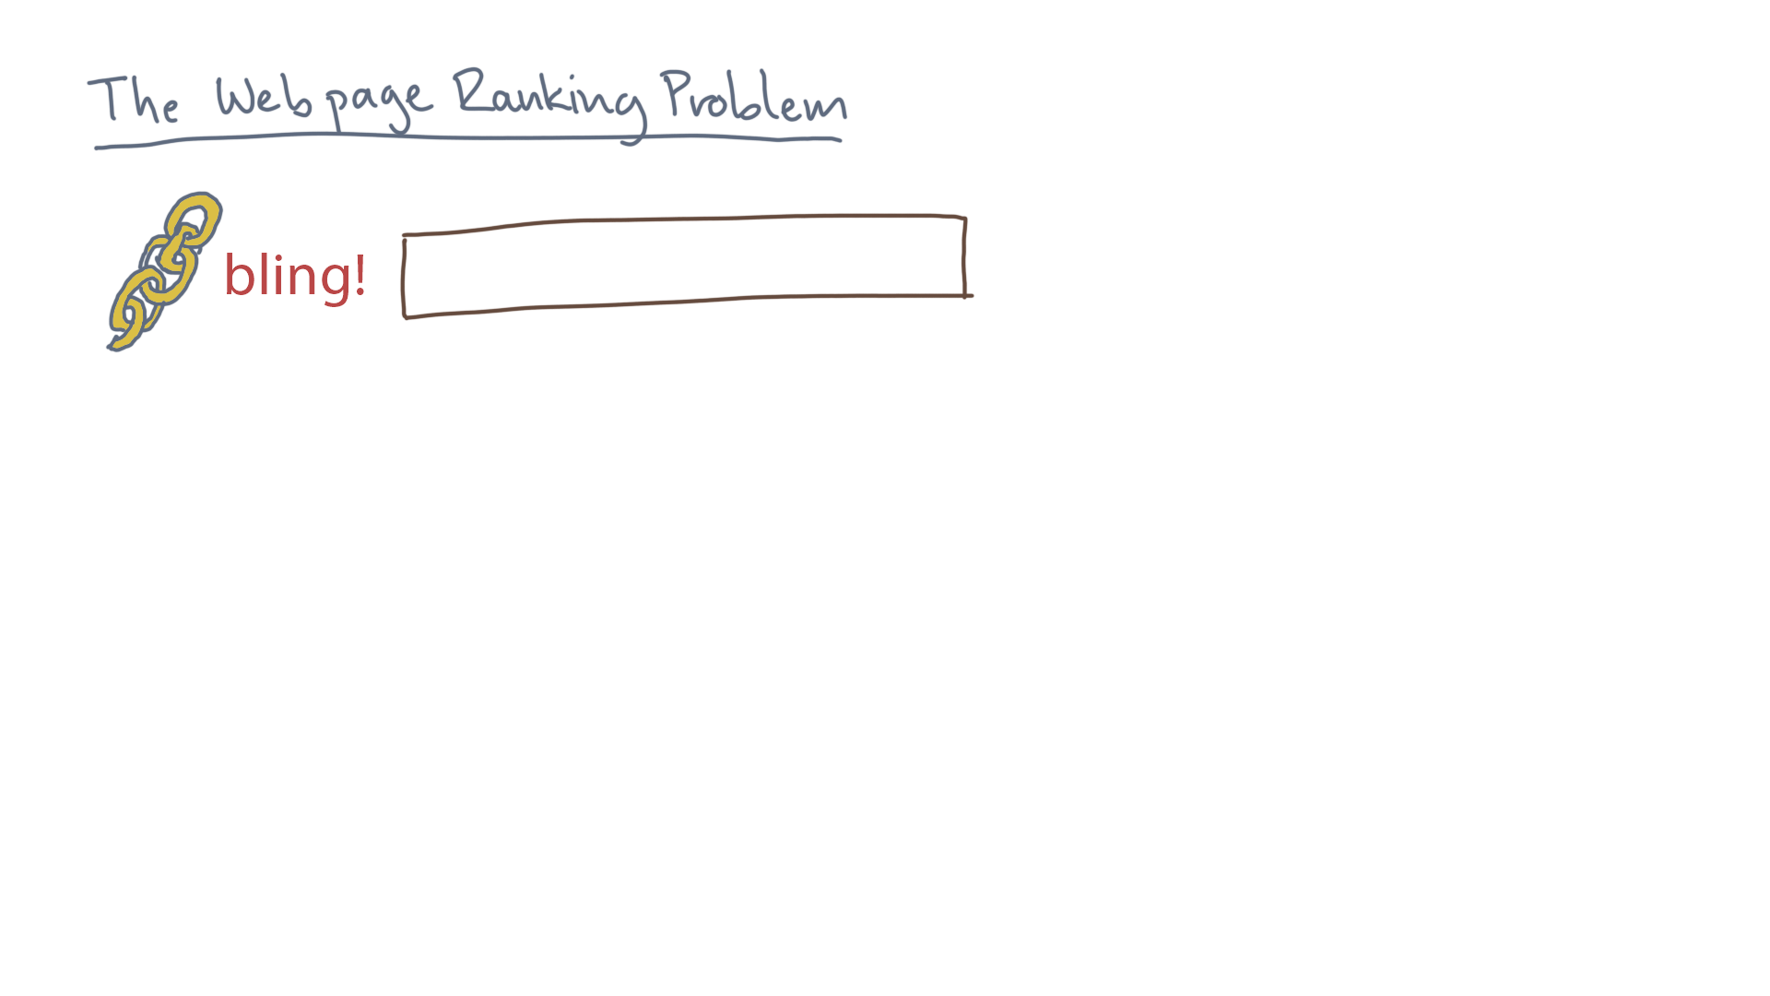
Notes:
Suppose you go to your favorite search engine and you type a query.

Slide 5
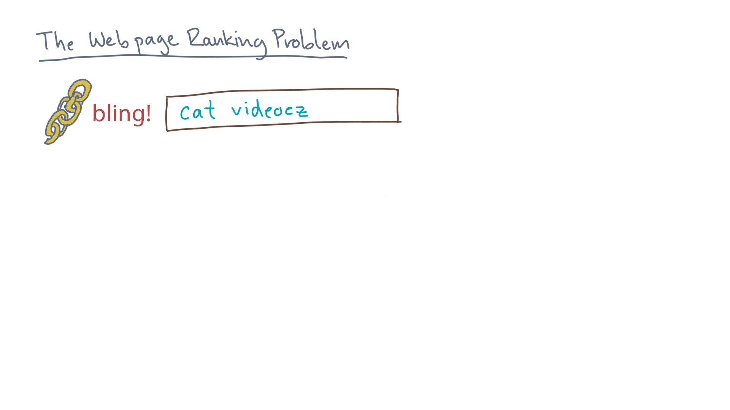
Notes:
The search engine returns a bunch of results.

Slide 6
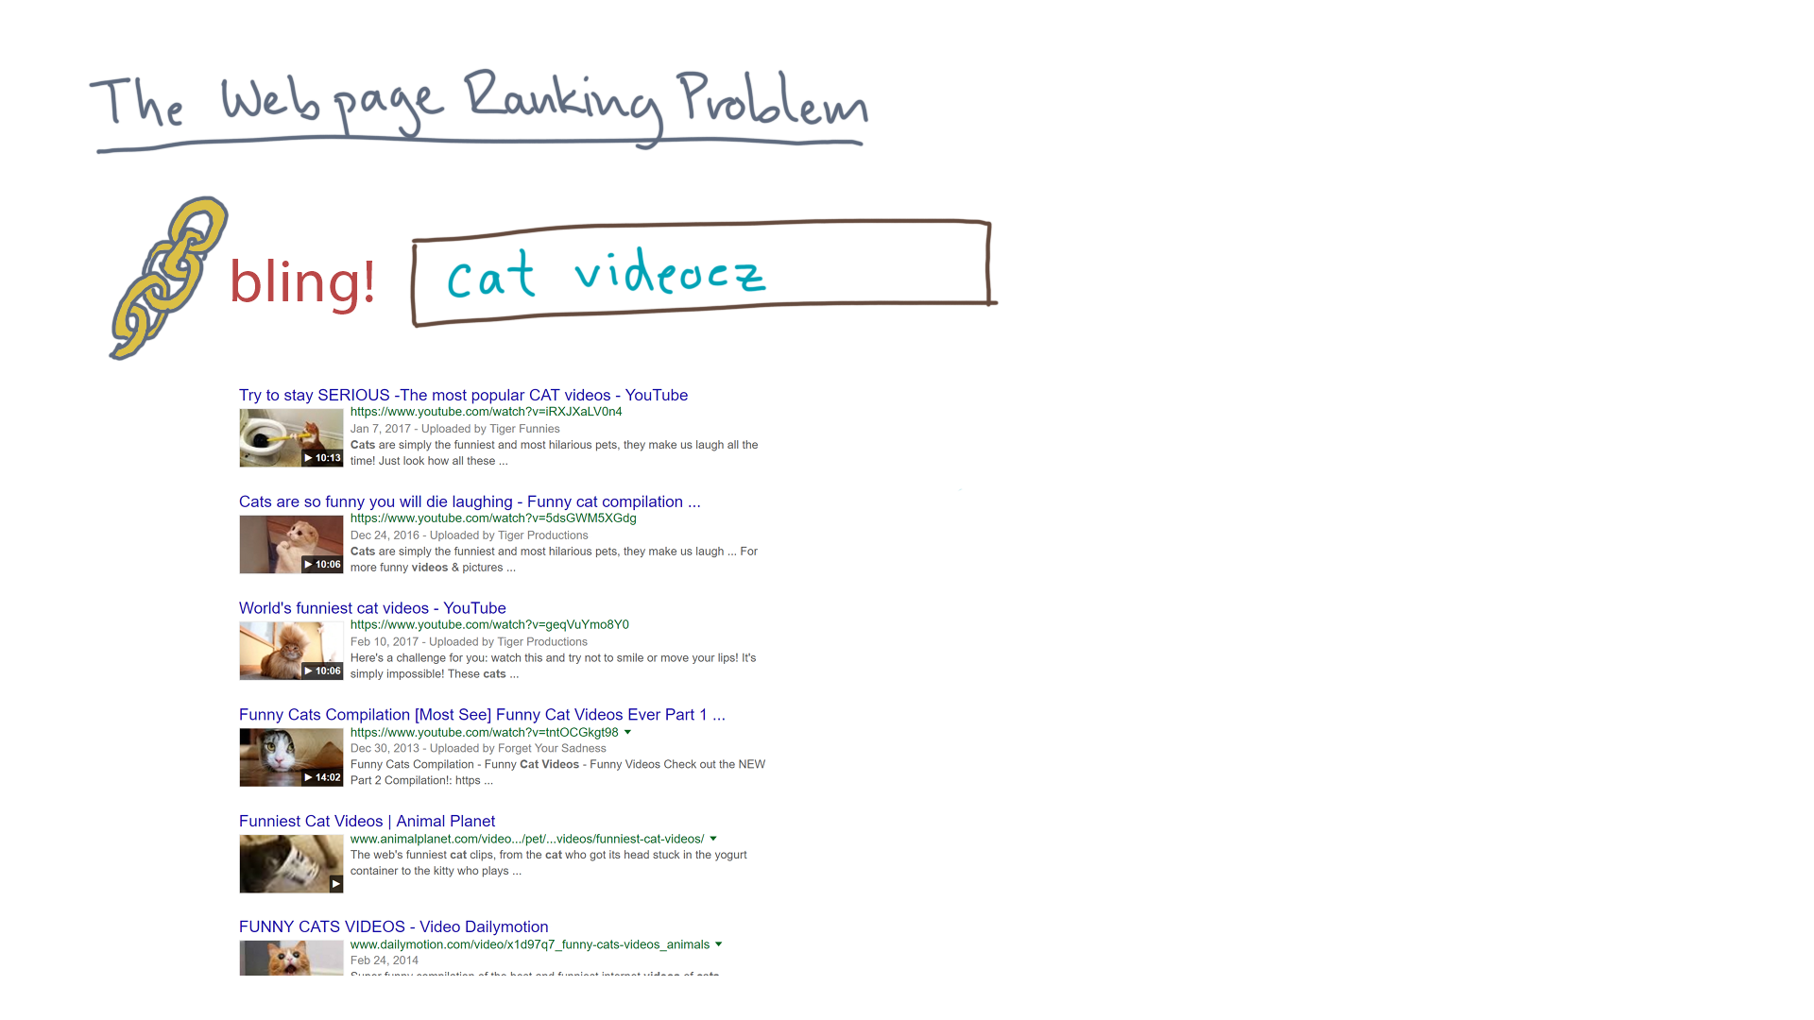
Notes:
Now you, as a user, will tend to scan these from top to bottom.

Slide 7
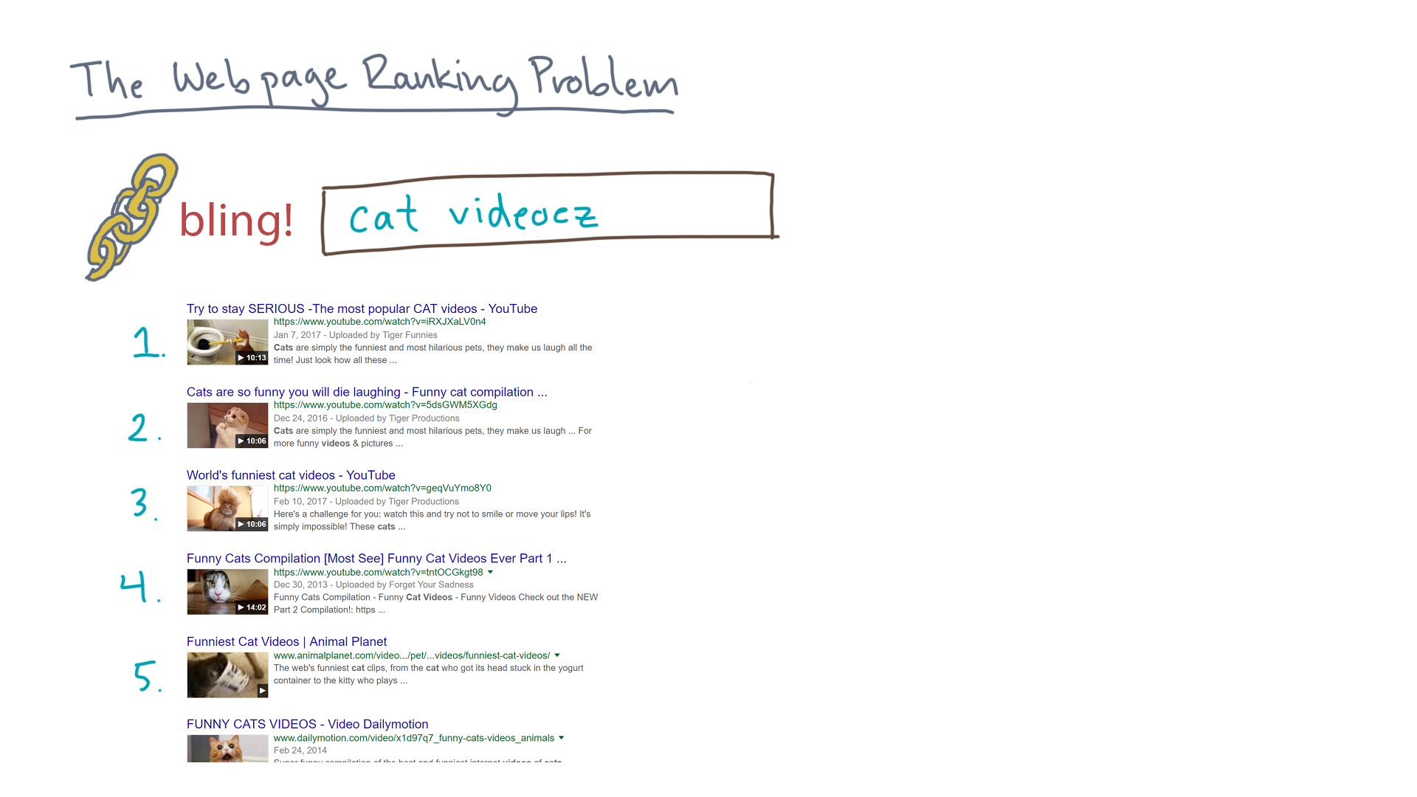
Notes:
So the ordering of the results matters, begging the question: where does this order come from?

Slide 8
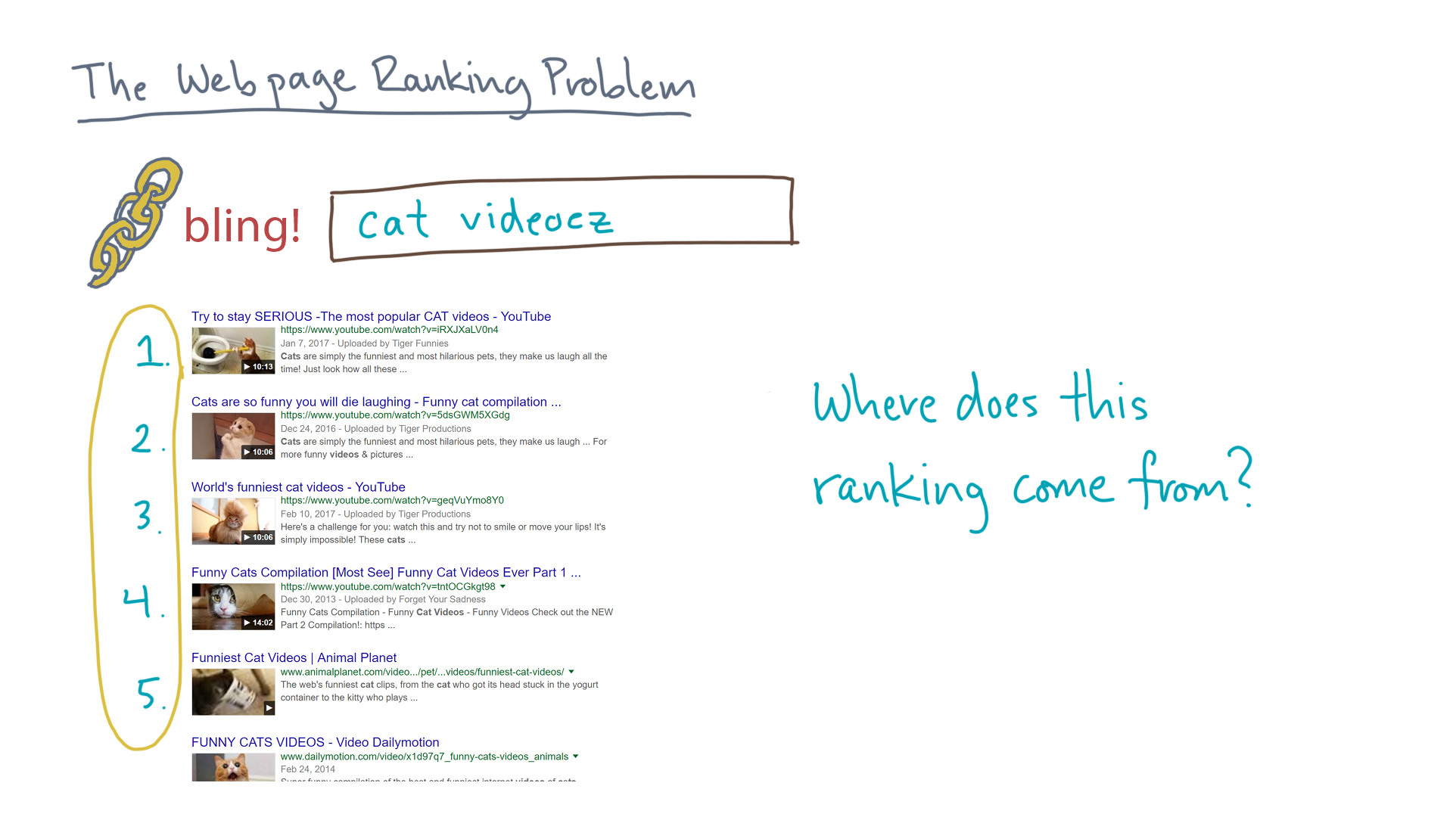

Slide 9
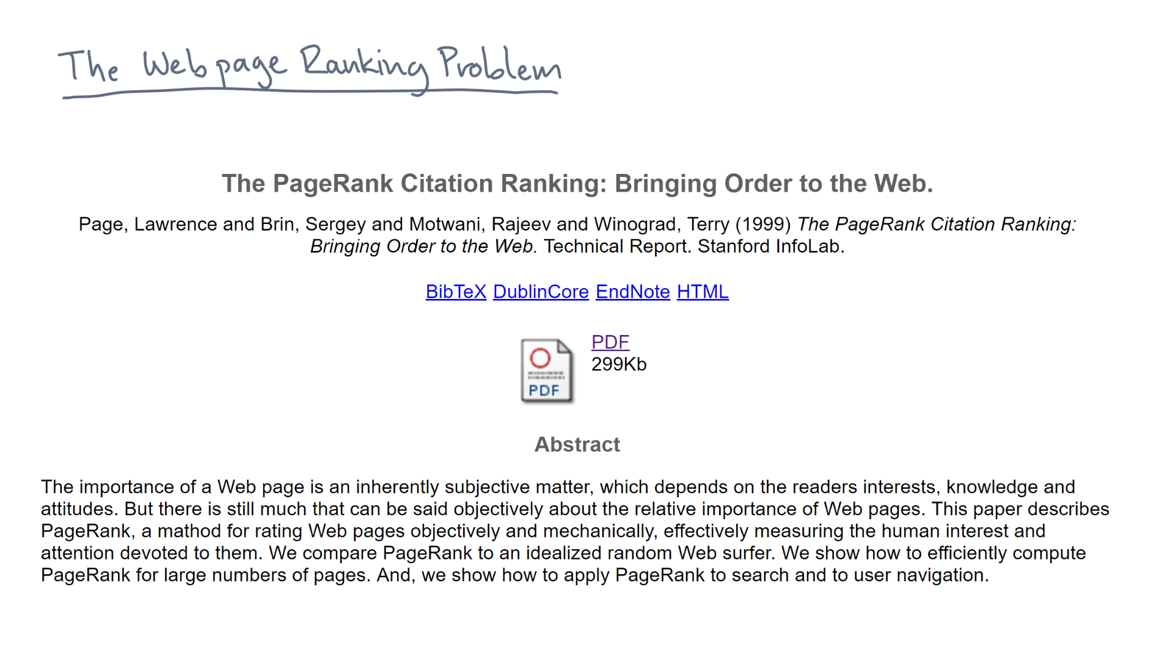
method
Notes:
In 1999, the founders of Google, Larry Page and Sergey Brin, had the following idea.

Slide 10
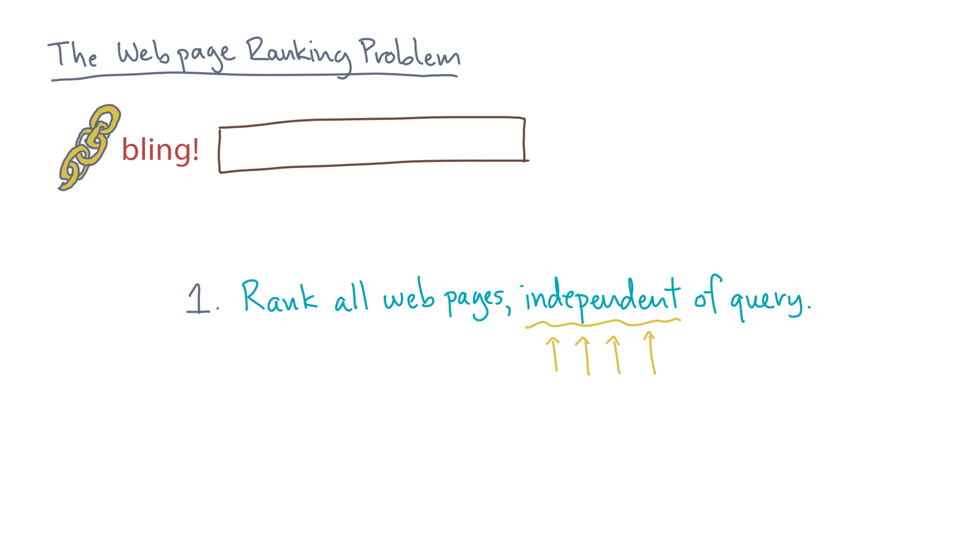
Notes:
First, come up with a way to rank all web pages.
I’ll explain their scheme in a moment.

Slide 11
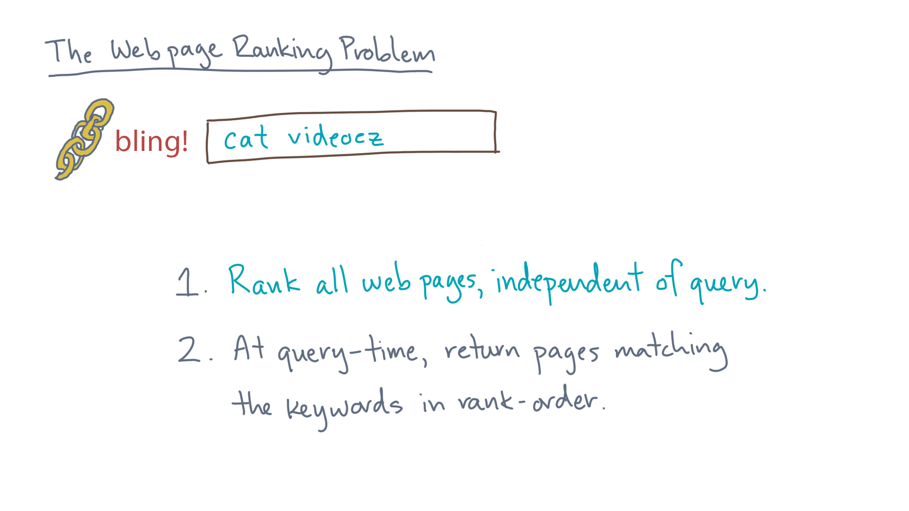
Notes:
Then, at query-time, when you know the user’s keywords, find all pages that match the search keywords and return them *in that precomputed rank order.*

Slide 12
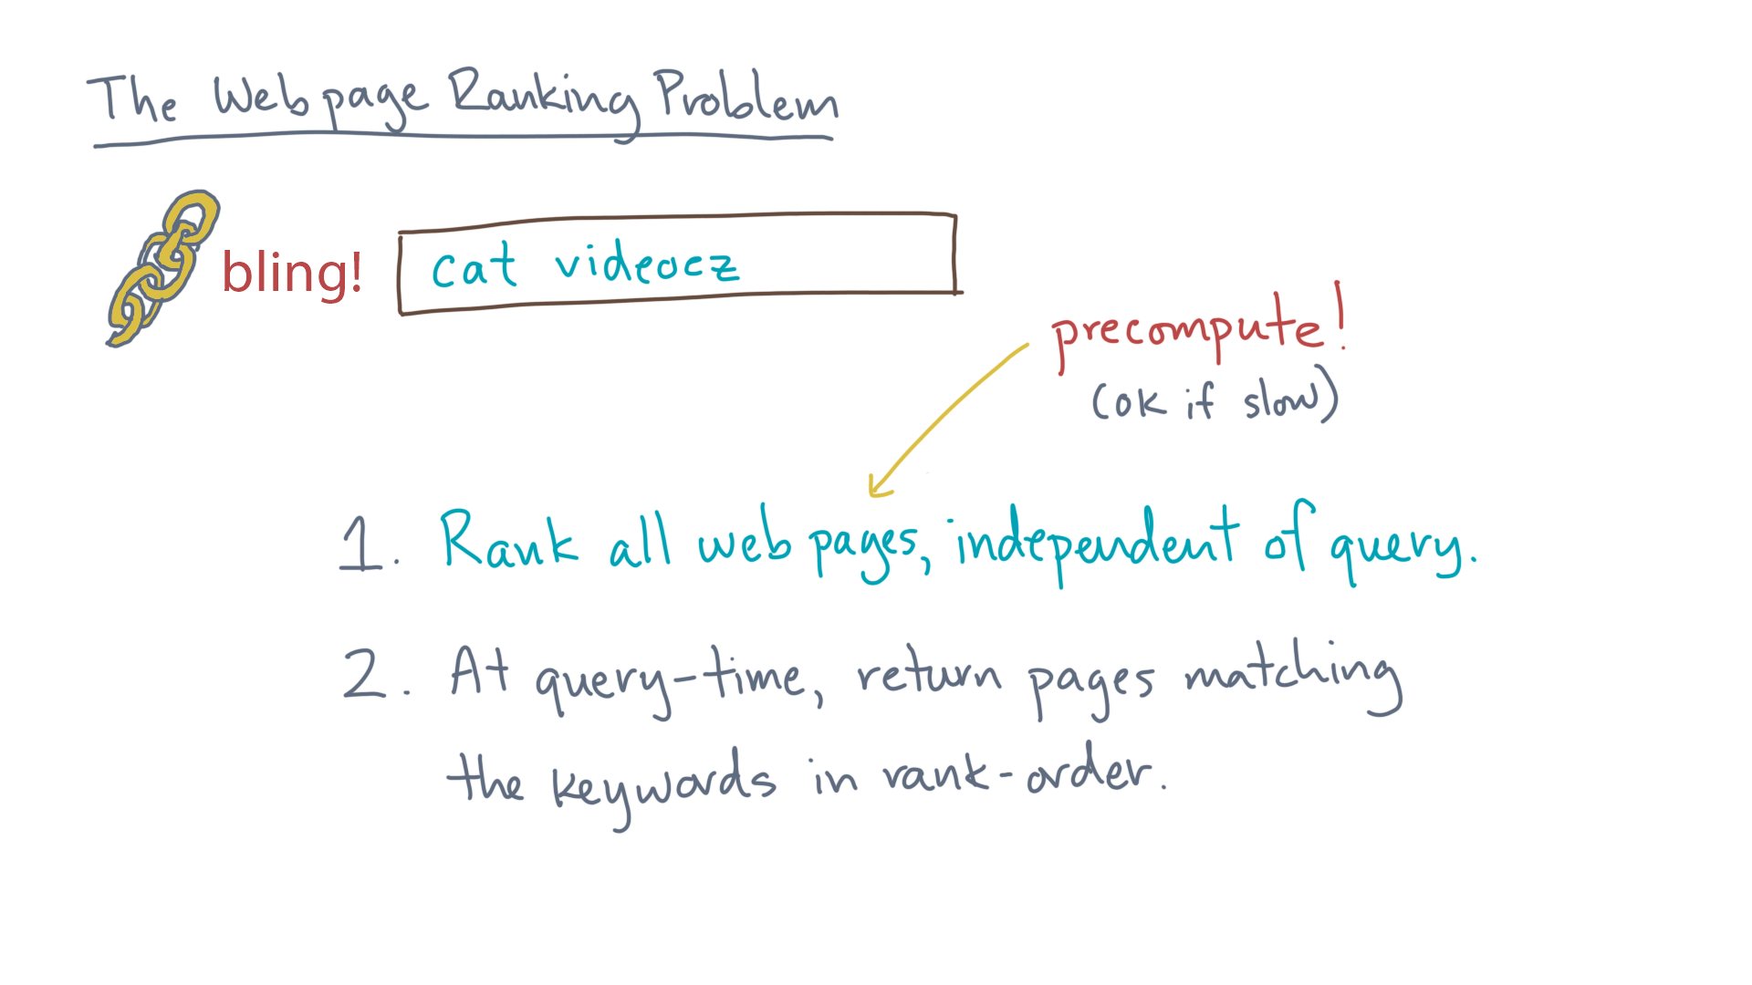
Notes:
Step 1 is something you can *PRECOMPUTE* from any snapshot of the web that you happen to have.
As such, even if it’s slow, it’s OK. (Well, as long as it’s not too slow.)

Slide 13
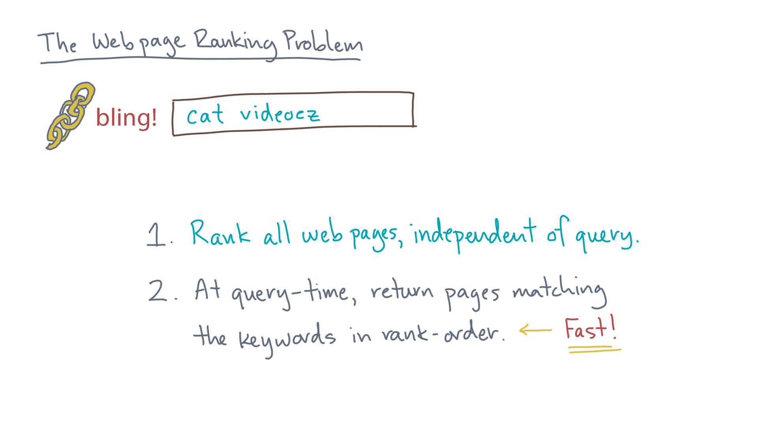
Notes:
The second step can be done in a way that is mostly just a “lookup”, and so it’s possible to do quickly.

Slide 14

Notes:
So how can we compute a meaningful rank?

Slide 15
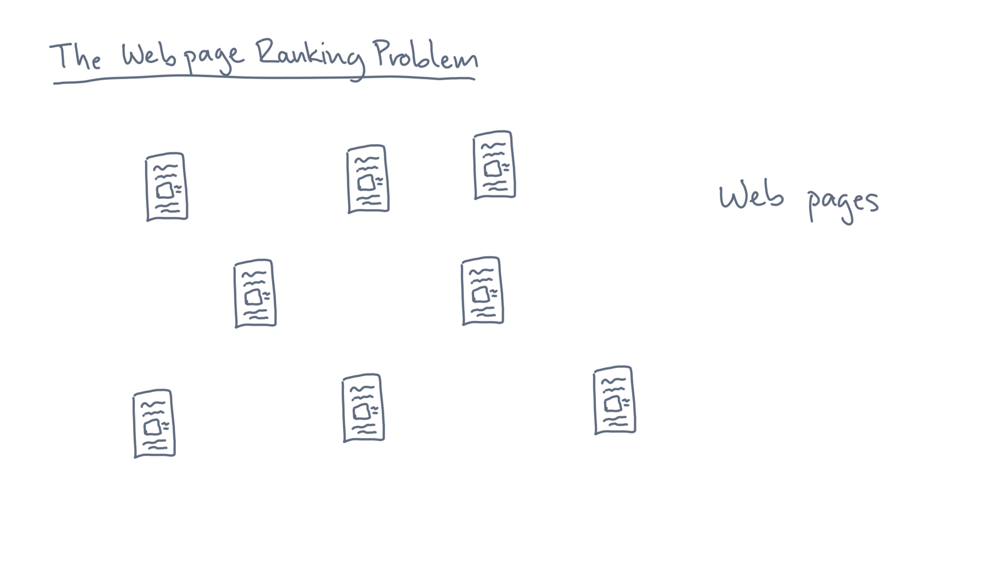
Notes:
The web consists of a bunch of pages.

Slide 16
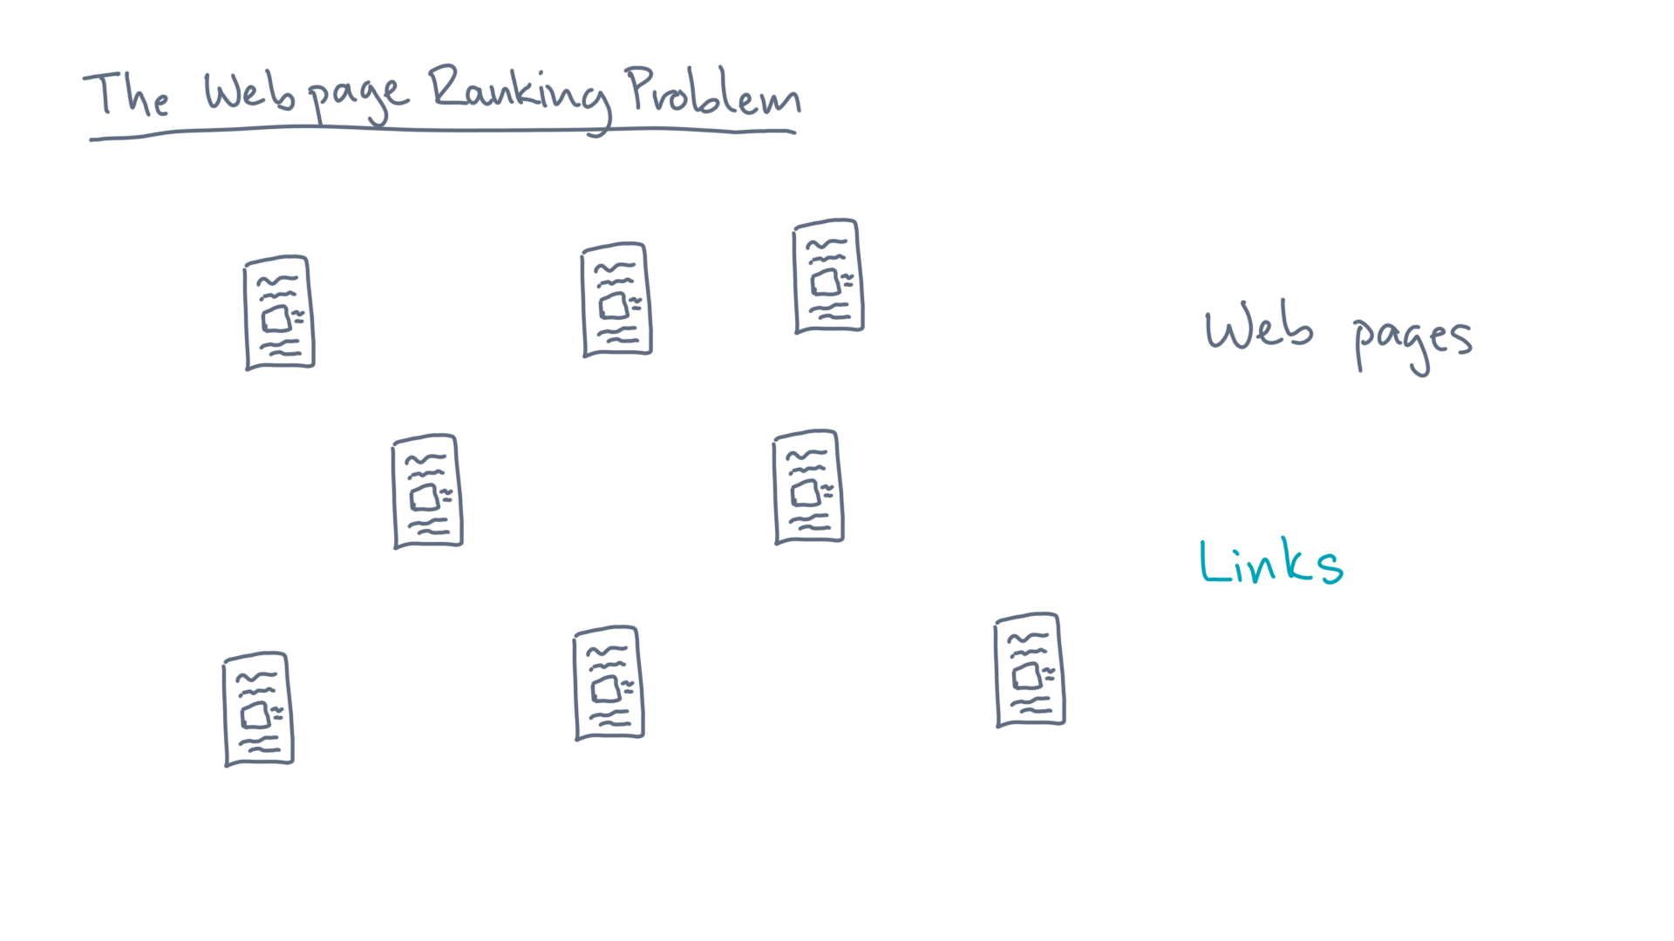
Notes:
And these pages link to one another.

Slide 17
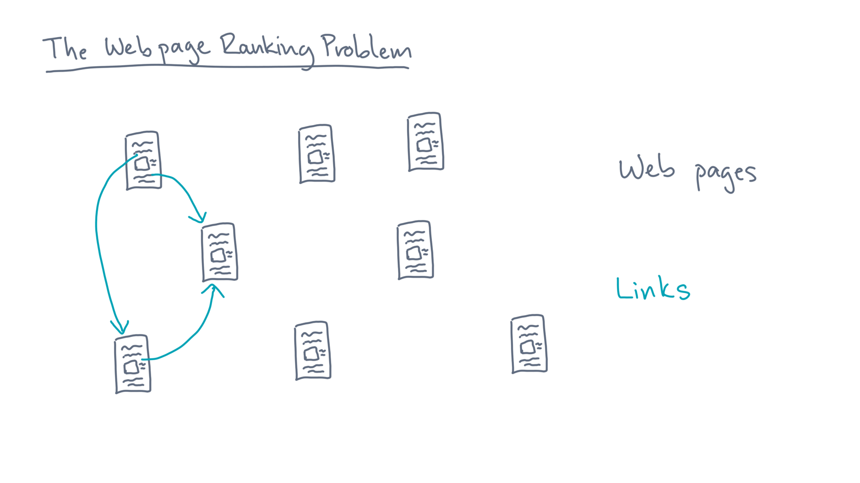
Notes:
Advance

Slide 18
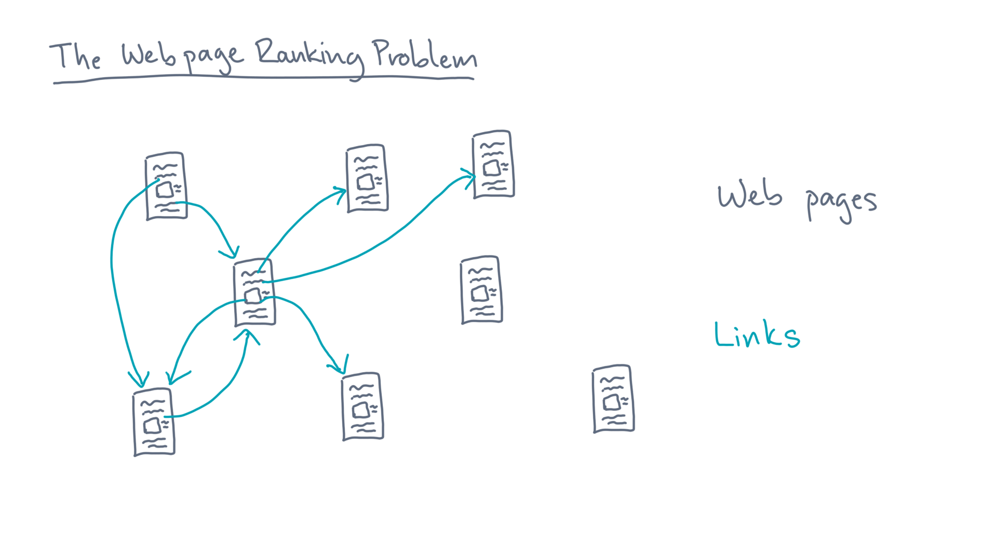
Notes:
Advance

Slide 19
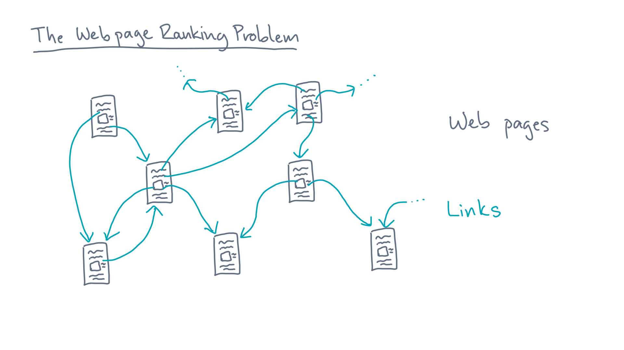
Notes:
[STOP] In computer science lingo, the web is a network or _graph_.

Slide 20
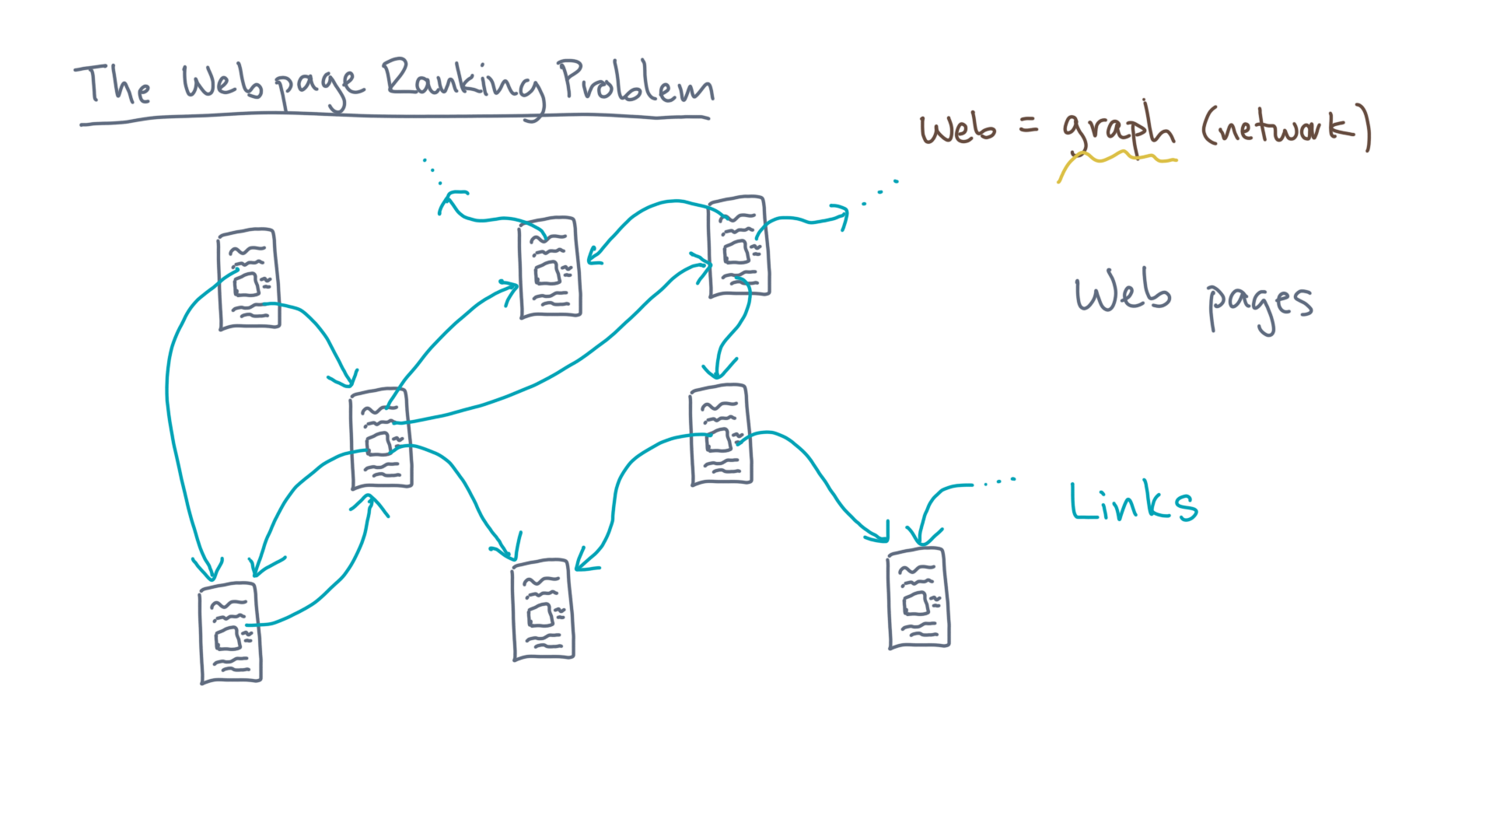
Notes:
The pages are _nodes_.

Slide 21
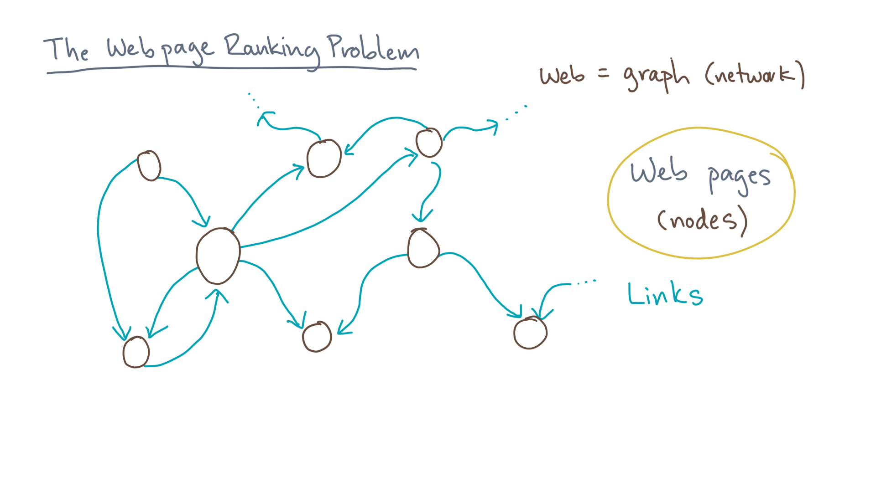
Notes:
And the links are _directed_ edges.

Slide 22
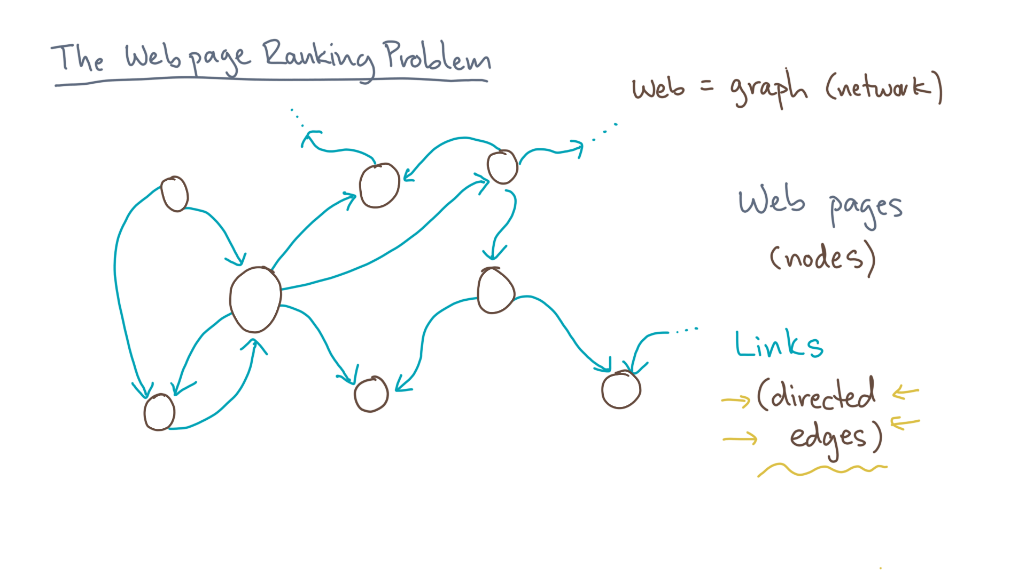
Notes:
So how do we turn this structure into a ranking?

Slide 23
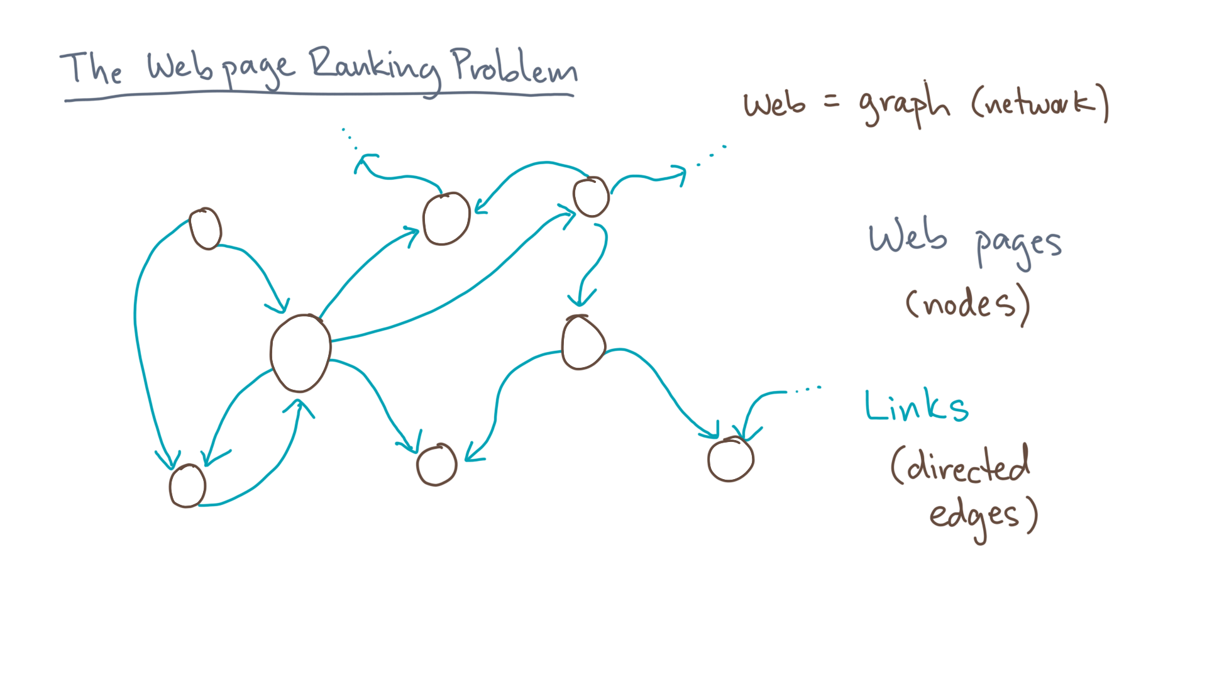
Notes:
Consider a “random web surfer.”

Slide 24
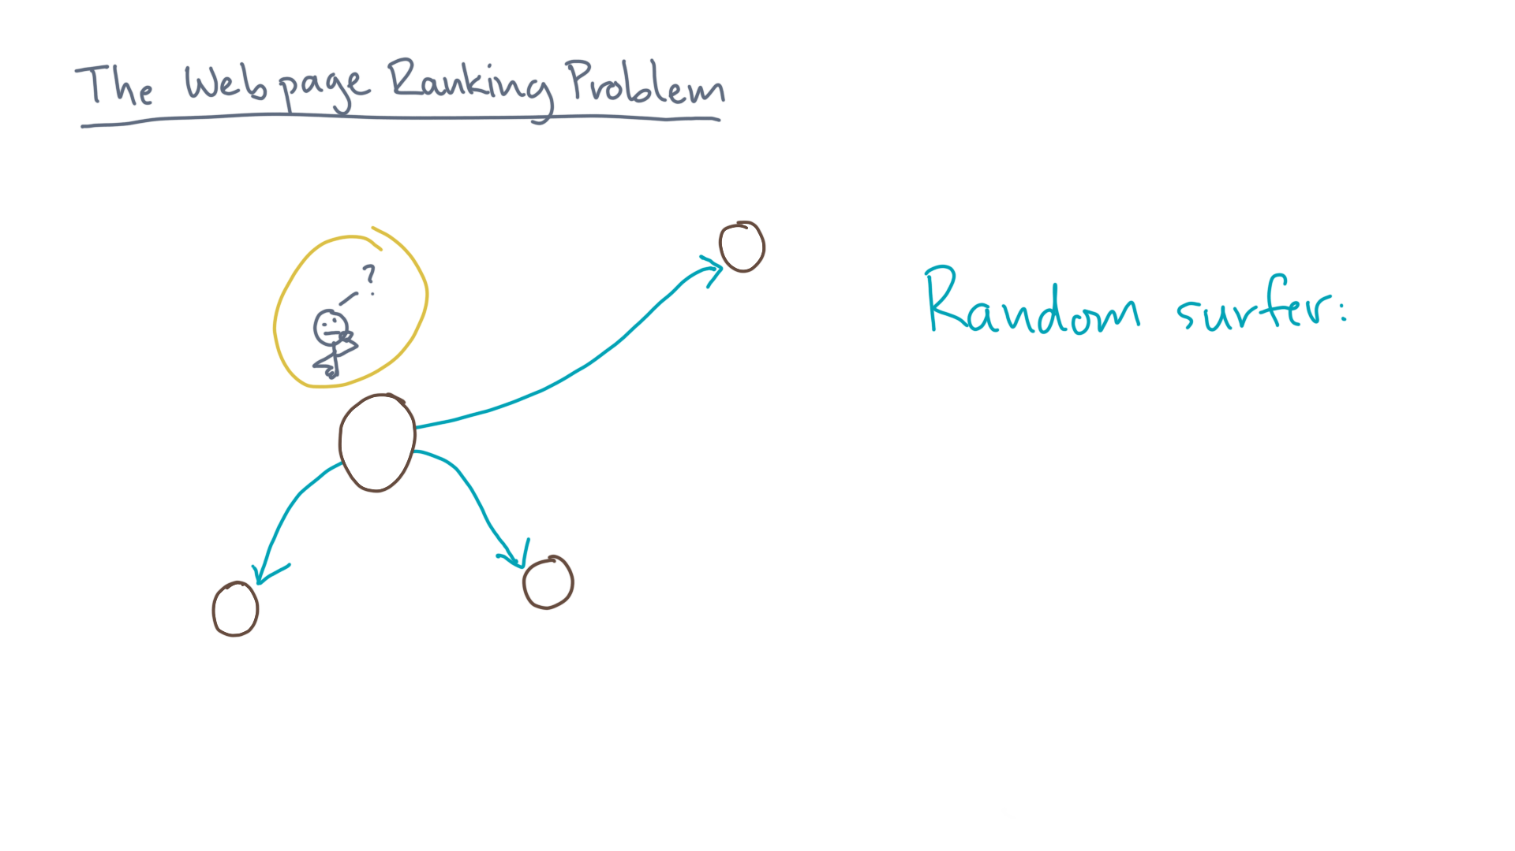
Notes:
That’s a person who, when visiting a web page, starts by considering all outgoing links.

Slide 25
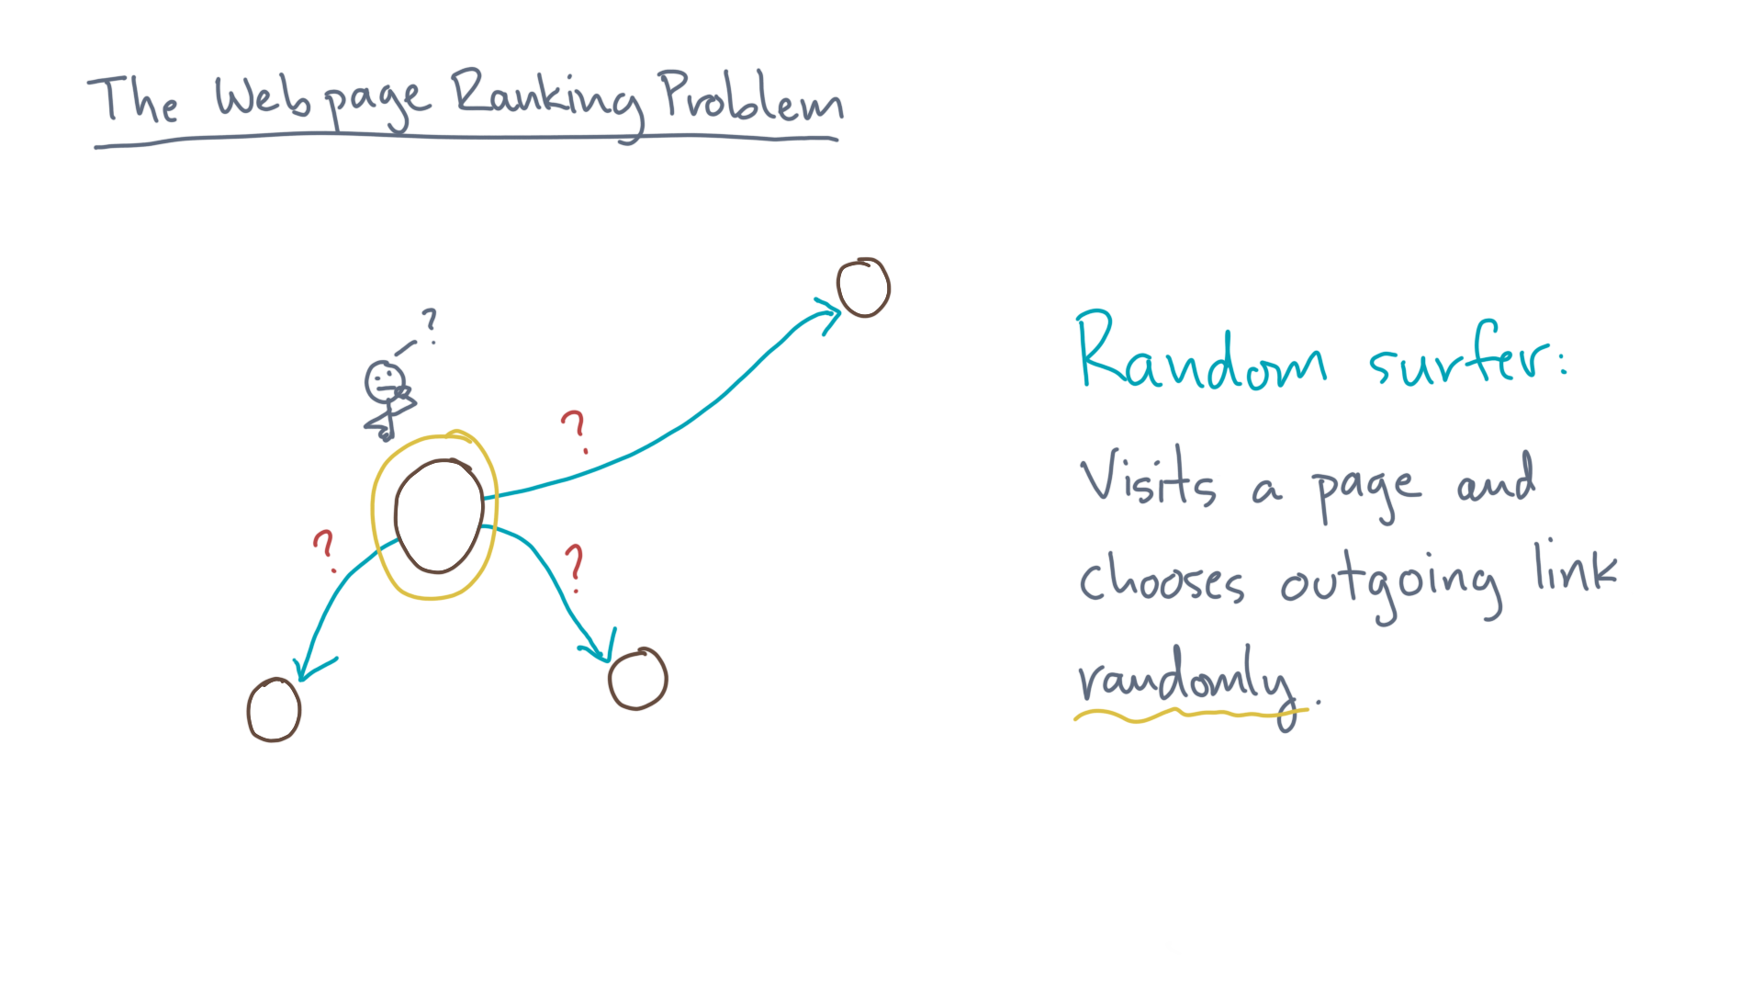
Notes:
He or then selects an outgoing link randomly.

Slide 26
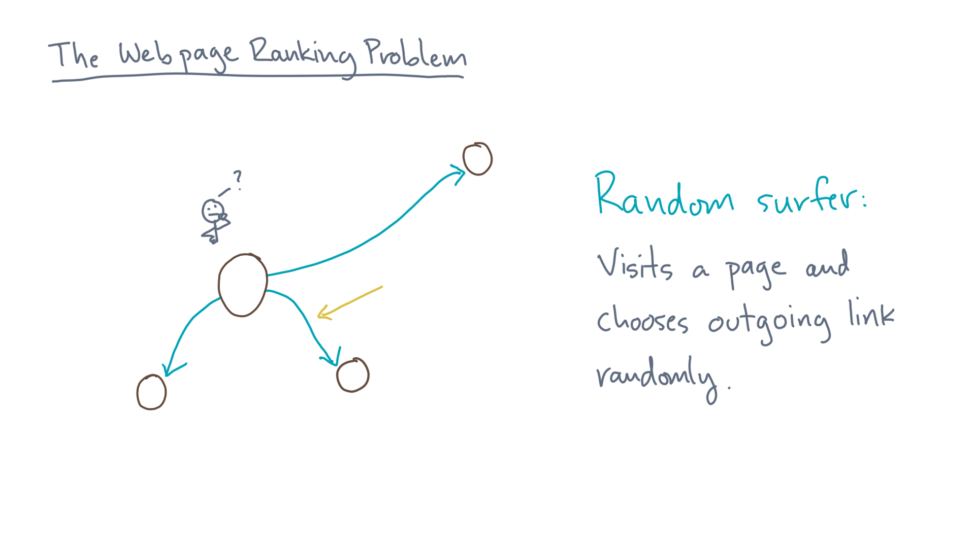
Notes:
[advance]

Slide 27
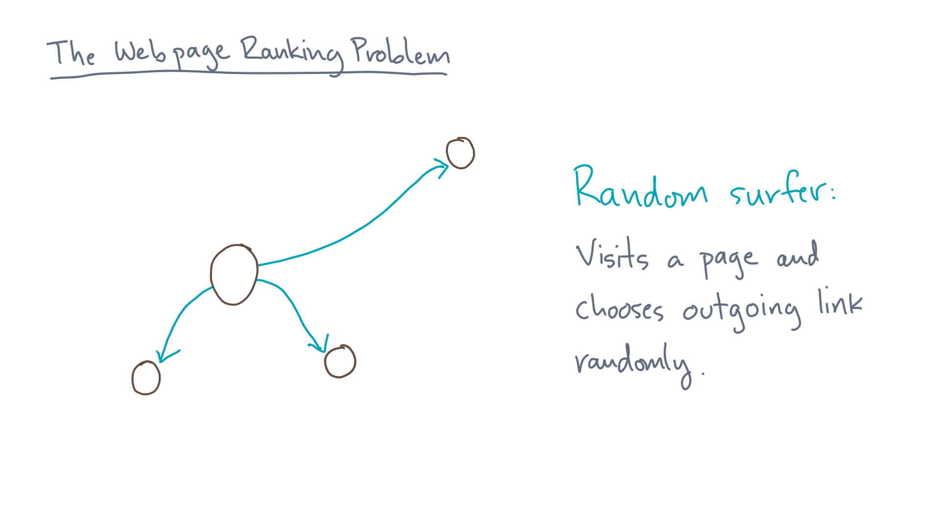

Notes:
[advance] This process would repeat forever.

Slide 28
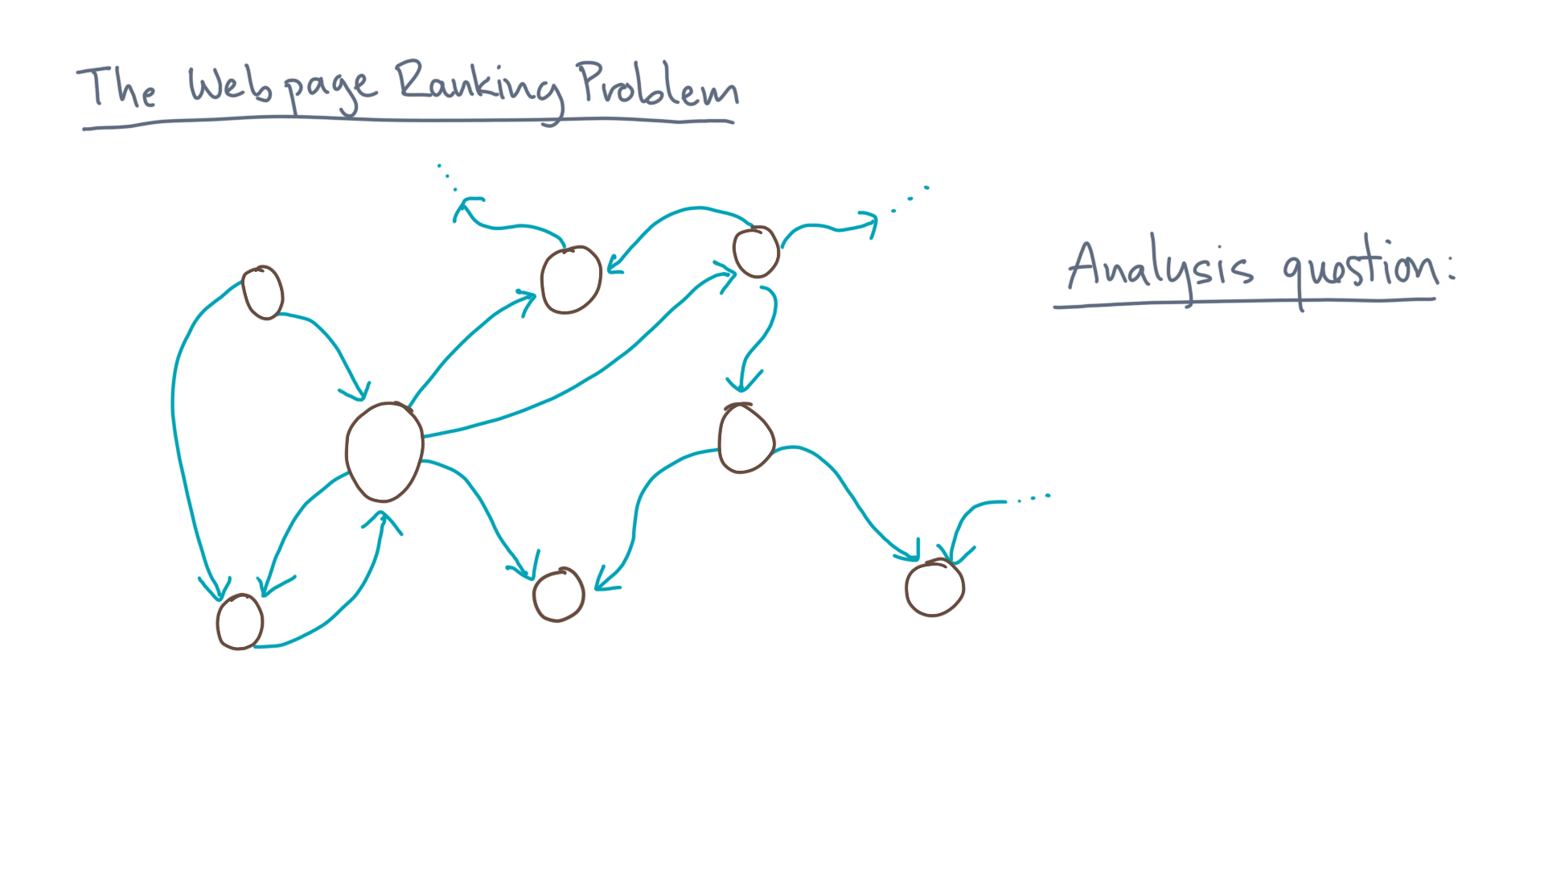
Notes:
The analysis question then becomes the following.

Slide 29
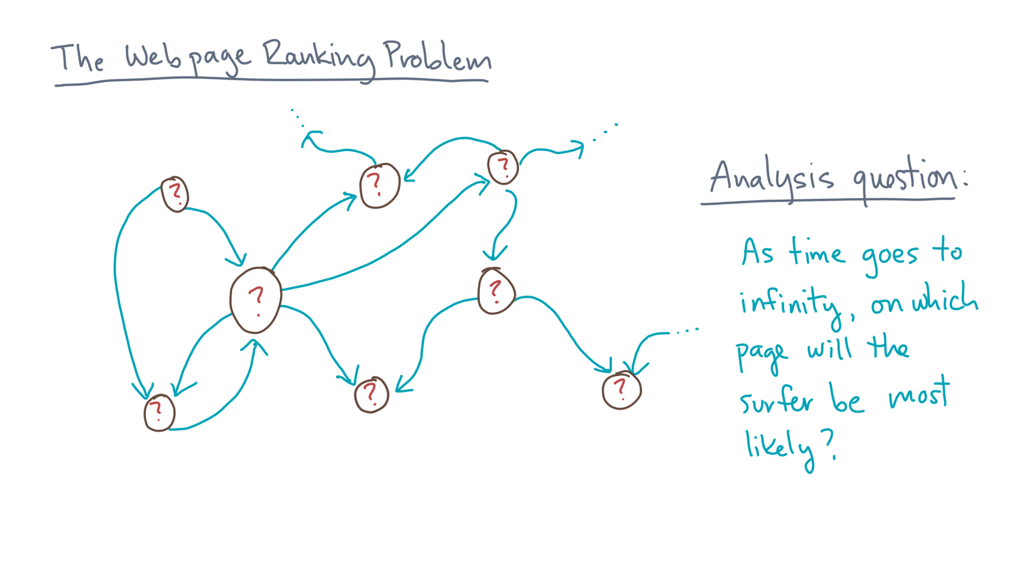
Notes:
If you ran this process for a very long time and then suddenly stopped it, on which page would the surfer most likely be?

Slide 30
Notes:
So that’s the PageRank idea, at a high-level.
Take a moment to digest it, and when you are ready for the nitty gritty details, move on to the next lesson.

